Slide 1
Welcome to Rishi Rush
By Eion, Rishi, and Ryan

Slide 2

What is this game about?
This game is based on the story about three young billionaires, who each gained their wealth through various methods.

Slide 3
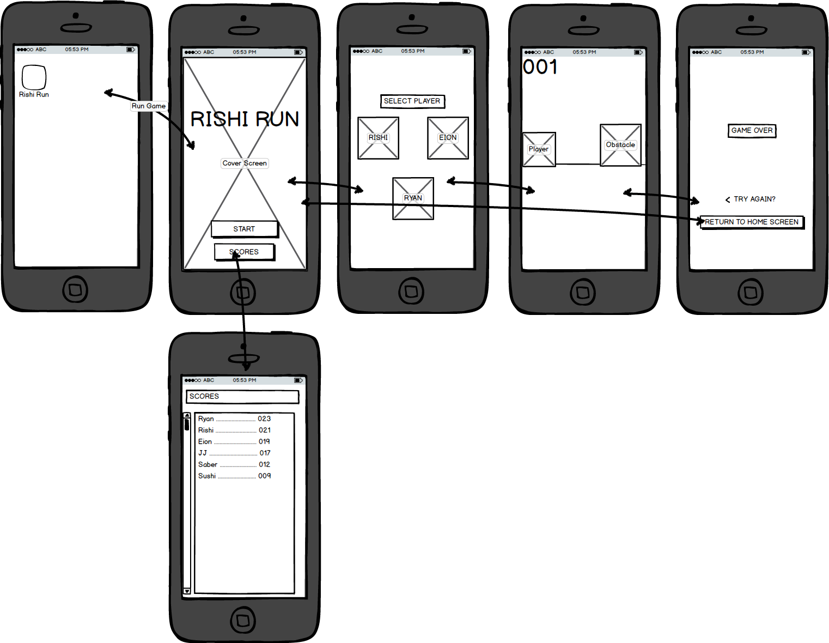
How is it structured?
WHAT WAS PLANNED ORIGINALLY:
Start/Splash Screen
Character Selection
Viewing Scores
Functional Gameplay
Compatible vertically and horizontally (in landscape)
WHAT DID HAPPENED:
We actually have game (somewhat)
It works (for the most part)
There’s no way to view the score history, BUT…
Rishi is the only playable character (so far).

Slide 4
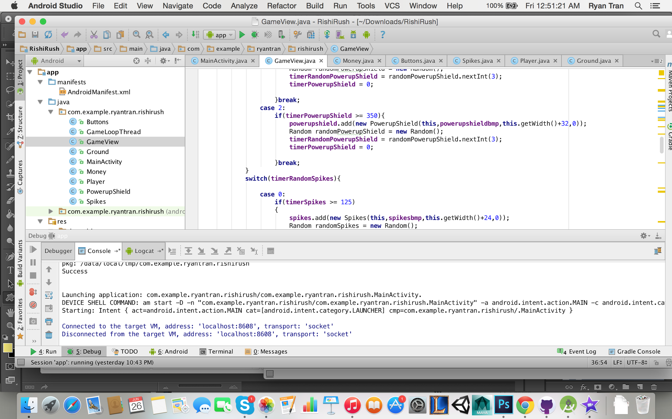






Graphics/Coding

Slide 5
Credit where credit is due.
This game was inspired by the tutorial “Programming an Endless Running Game” series by Linus Granath: https://www.youtube.com/watch?v=PIG0yQ1o13w
Coding/Processing - Rishi Patel and Eion Daley
Graphics and Presentation Video - Ryan Tran

